Slide 1



Slide 2
2.THE WORLD OF GREEN
CONTENT:
. PARTS OF A PLANT
. FUNCTIONS OF PLANT PARTS
. TYPES OF ROOTS
. TYPES OF PLANTS
. CARING OF PLANTS.
CHAPTER2/KARUNAMBIGAI/SCIENCE DEPT/SNS ACADEMY

Slide 3
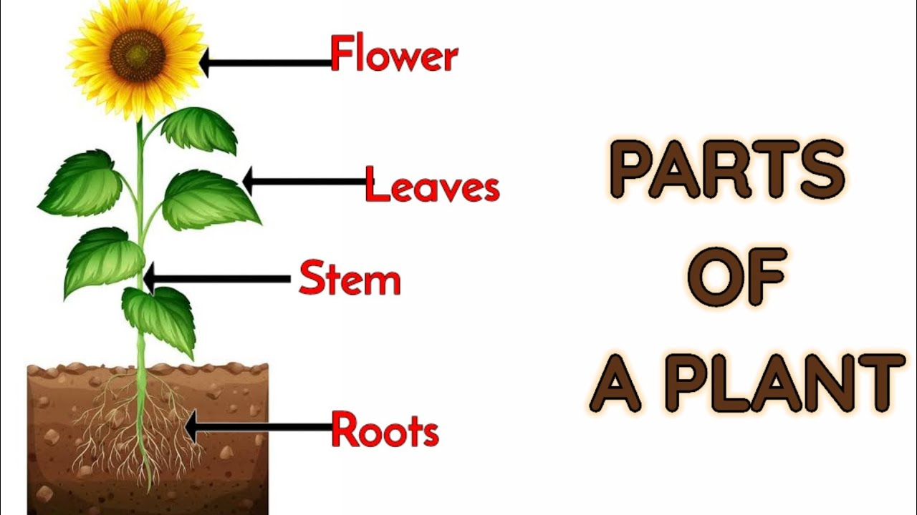
PARTS OF A PLANT
Chapter 2 /Science Dept/N karunambigai/SNS academy

Slide 4
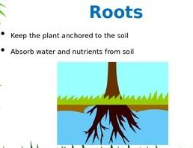
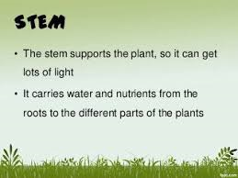
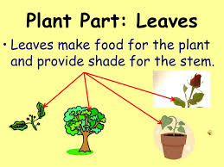
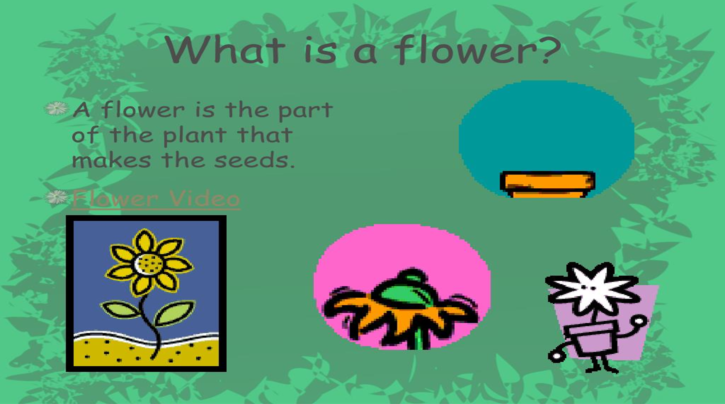
FUNCTIONS OF PLANT PARTS

Slide 5
PARTS OF A PLANT
FUNCTIONS OF A PARTS OF A PLANT
S.NO | PARTS OF A PLANT | FUNCTIONS
1. | LEAVES | PREPARES FOOD FOR THE PLANTS.
2. | STEM | CARRY FOOD AND WATER TO ALL PARTS
3. | ROOT | IT ABSORBS WATER AND MINERALS FROM THE SOIL.
4. | FLOWERS | THE PART THAT PRODUCES SEEDS OR FRUITS
5. | FRUITS | CONTAINS SEEDS
6. | SEEDS | PART FROM WHICH BABY PLANT GROWS AND IT IS PRESENT IN THE FRUIT

Slide 6
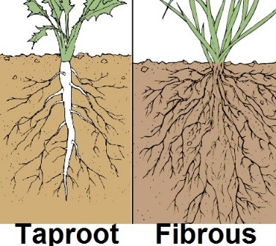
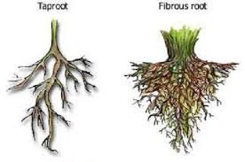
TYPES OF ROOTS

Slide 7
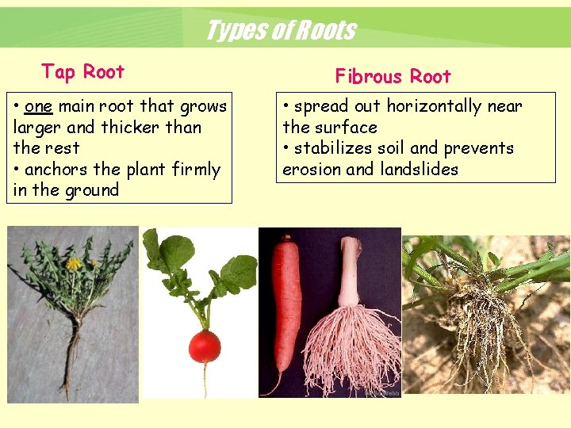
CHAPTER 2 /KARUNAMBIGAI/SCIENCE DEPT/SNS ACADEMY
DIFFERENCE BETWEEN TAP ROOT AND FIBROUS ROOTS

Slide 8
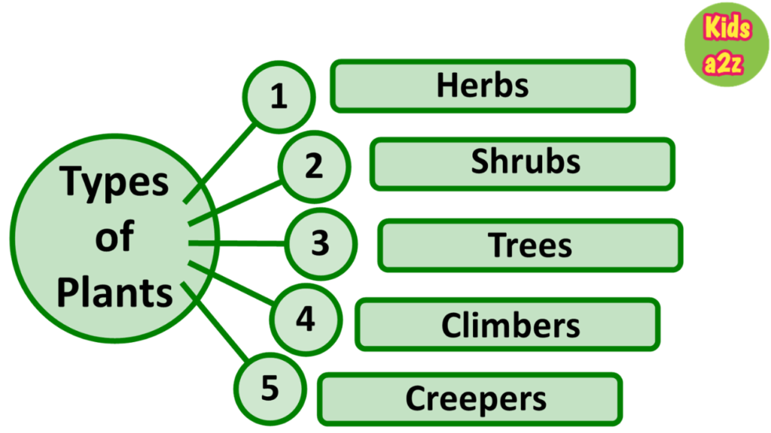
Chapter 2 /Science Dept/N karunambigai/SNS academy
TYPES OF PLANTS

Slide 9
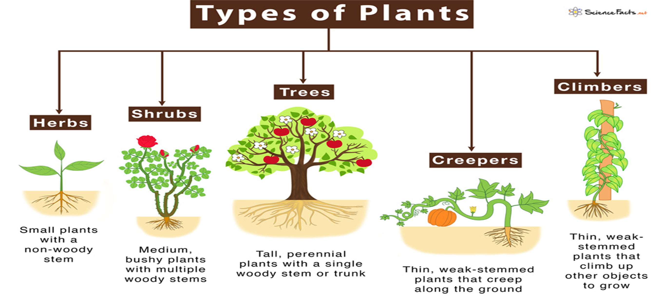
TYPES OF PLANTS

Slide 10
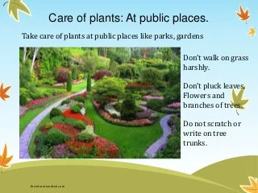
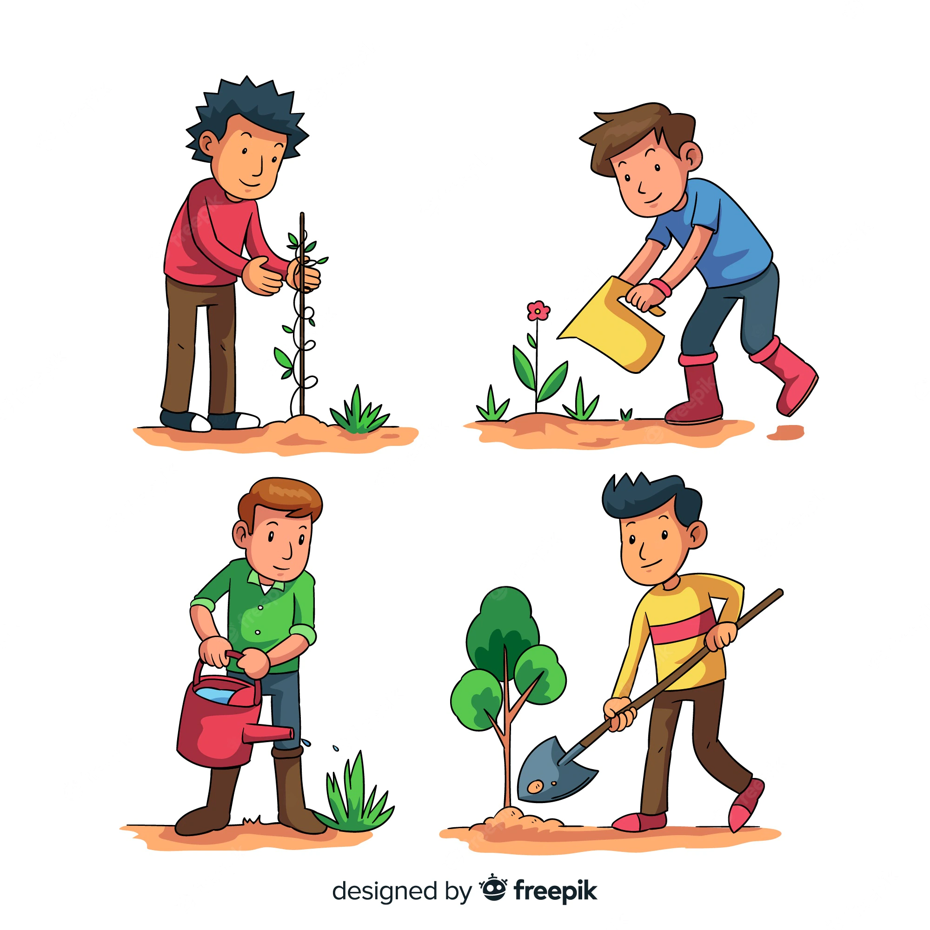
CARING OF PLANTS
CHAPTER 2 /KARUNAMBIGAI/SCIENCE DEPT/SNS ACADEMY

Slide 11

Chapter 2 /Science Dept/N karunambigai/SNS academy

